Slide 1

Small Business
Day-to-Day Cash Flow Management

Slide 2
Managing your cash flow in the midst of Covid-19
Financial Toolkit
Using Spreadsheets//
Using Cashvue//
Cash flow management allows you to identify your exact cash inflow and outflow on a daily/weekly basis to better understand where your business stands in the immediate future. Establishing an iterative process and perspective to cash flow management helps you pivot quickly and take action as needed to keep you ahead of the game.
Small Business
Day-to-Day Cash Flow Management

Slide 3

Agenda
Introduction
What is active cash flow management?
What I need to do to start managing my cash flow?
What is in the Cash Flow toolkit?
Questions & Answers

Slide 4
Differences between financial forecasting tools.
Pro Forma
Budget
The forcasting and estimation of the operaton income and expenses in the next 3-5 years based on the operational plan, investments and strategy.
A plan on the spending limits for different areas of the operations based on historical trends and future assumptions, 1-year trajectory.
Statement of Cash Flow
Cash Flow Projection
A financial statement that correlates with the company‘s income statement and balance sheet to show the effect of cash in operating, investing and financial activities.
A statement that presents the expected cash inflow and cash outflow and its impact on liquidity over time. Assumptions are made to align with current information about operational circumstances in the near future, 3-6 months trajectory.

Slide 5
What is cash flow management?
Future
Today
01 Fixed Costs
02 Relavant Trends
03 Last 6 months of activity
Assumptions
Some History
Today
Forecast
Iterations
01 Forecast general inflows and outflows
02 Make assumptions about collections, payments
03 Continuous weekly and monthly updates to forecast based on new information
Accounting, Bookkeeping
Notes:
Now, I am aware that the word “cash flow” can mean many things. Here, specifically, I am talking about the prediction of inflows and outflows in an organization against time. In other words, how much money in the bank today, tomorrow and six month from date.
Controllers spends about a day a week on this stuff. And at the height of the last recession, I spent nearly 75% of my time making sure my clients are going to make payroll.
The process is messy:
It is juggling spreadsheets
It is coordinating money against future business activities
Numerous meetings and note taking on what is going on in the company
And answering questions like:
What is our runway
What happens if collections get delayed
When will we run out of money

Slide 6
The importance of cash flow management in a company.
01
Know your cash position at the end of each week (day, month).
Implementing an iterative cash flow projection process lets you be two steps ahead of an ever-evolving future.
02
Manage cash activities under a tight budget.
03
Give immediate visibility to any misalignment of cash inflow and cash outflow.
04
Plan next steps and make changes quicker.

Slide 7

What are some terms I should be familiar with?
Cash Burn (net cash)
Opening Cash (cash start)
This is the difference between cash inflow and cash outflow (inflow – outflow = burn. +Burn = more cash brought in than cash spent; -Burn = more cash spent than the amount brought in.
The starting cash position of your cash flow projection. This may represent one or more than one bank account balances.
Cash Inflow/Outflow
Cash Runway
The cash expected to be deposited and collected; the cash expected to be spent on payroll, rent and vendors bills in the immediate future.
The number of days into the future which the company is expected to remain solvent. Based on current assumptions, how long the money will last.

Slide 8




Who should participate in cash flow planning?
CEO (owner, members)
CFO (controller, bookkeeper)
Understands the business.
Understands the money.
Ability to provide realistic perspective about funding and business direction; ability to make quick decisions that may have dramatic impact on company.
Ability to provide status of customer receivables and collections; status of payables, loans and bank trends and balances.
COO (managers)
CRO (sales director)
Understands the operations.
Understands the revenue.
Ability to provide insight on operational necessity, timeline and priorities; thorough understanding of relational hierachy of things, people and employees.
Ability to provide up-to-date sales status, customer pulsing and contract pipeline; owns sales strategy, sales projection and trends.

Slide 9
How do I get started?
// Gather your team.
// Modify a cash flow projection and cash flow runway template to fit your current needs.
Form the cash flow management committee, involve key decision makers, financial managers, and department managers.
Determine if you need to see your cash positon broken down by week or by day; modify the template to track the most important category and line items impacting cash flow.
// Get the most up to date payable listing and spending breakdown in last 3 months.
// Get the most up to date account receivable listing and upcoming collection statuses.
AP aging report, any report that breaks down actual cash spending by vendor and category, and any reoccuring charges and commitments i.e. payroll, rent, software subscriptions.
AR aging report, collection report and any notes regarding project statuses, sales trends, and collection statuses by project, customer and timeline.
// Create a reocurring invite to team for cash flow meeting at same time each week.
// Identify expectations of income and expenses for the next 3-6 months.
Establish the meeting time and day that would repeat each week. Identify the reports and information required for each meeting.
Obtain your starting cash position, populate your cash expectation 3-6 months from date; input future customer collection, payroll and vendor payments per your most up to date understanding and notes.

Slide 10
What do I do weekly?
STEP 1
STEP 2
STEP 3
STEP 4
STEP 5
Compare last week‘s actual cash inflow and cash outflow from the bank to what was projected on your cash flow runway; adjust and true up last week‘s numbers; last week‘s ending is now this week‘s starting cash.
Review current AR and AP Aging, identify any new or revised expectations about the amount and the date which customer collection is expected to deposit into bank, and date and amount of payroll and vendor payments.
Populate and realign upcoming cash inflow and cash outflow into the projection. Be sure to input a cushion value to absorb small purchases and potential discrepancy in your expectations.
Evaluate cash runway, liquidity and business sustainability. Determine next steps and actions i.e. reduce cost, renegotiate with vendors and customers, loans, phone calls, promotions.
Repeat steps 1 – 4 each week, extend the cash flow projection and runway each week; make notes of each meeting and the game plan for the next several weeks.
True Up
Adjust
Project
Evaluate
Repeat

Slide 11

Its all about forward thinking.
Its all about forward thinking.
You will not be 100% accurate, but your projection should give you a close enough realistic view of where your company stands in the next 90 - 180 days.
Commit to the details.//
Cash flow management is a practice that requires discipline, accurate information and keen attention to changes that would impact your business.

Slide 12
Frequenty asked questions.
Q: Should the cash flow projection be trued up and adjusted before my cash flow meeting?
Yes. Have your financial controller reconcile your previous week‘s projections before the meeting. If there is a delay in customer collection or payment to vendors, move those specific cash expectations to the week that you think is most realistic based on current notes and understandings.
Q: How do I determine the increment of my cash flow breakdown – monthly, weekly or daily?
Depends on how tight your cash situation is right now. Your cash flow acts as a plan for your team to decide what customer to call and who to pay, how much to pay and when to pay. If customer collection comes in frequently (such as in retail) and it is neccessary to pay vendors often (to maintain inventory) and your liquidity is sensitive to depletion – then it is best to plan everything out on a daily basis.
Q: How often should I double check the formulas in my cash flow spreadsheets.
Weekly. It is important to review all the formulas used in the spreadsheet weekly. Errors do occur and you do not want to base your plans on numbers that did not add up correctly.
Q: What do I do with miscellaneous expenses that are creating small variances in my cash flow ending?
Determine the materiality of the variance of the cash ending projected last week. For small miscellaneous expenses, you can make adjustments to a miscellaneous line item on your cash flow projection in order to true up your numbers. For bigger variances, identify the source of the error and immediately revise your future expectations to avoid a similar false understanding about your cash position.
Q: What if I have credit cards and/or line of credit?
Depends what you want visibility in each week. If items charged to your credit card are important to see each week in its own line item, then you can add a line in your cash flow projection to account for the additional “money“ borrowed from your credit card or line (this will add back into your cash balance). You will need to project when you will actually pay your credit card (this would be a decrease in your bank balance). If individual items charged to your credit card are not important, then you can dedicate a line on the cash flow projection to input when and how much you plan to pay in the future against your credit card balance.

Slide 13
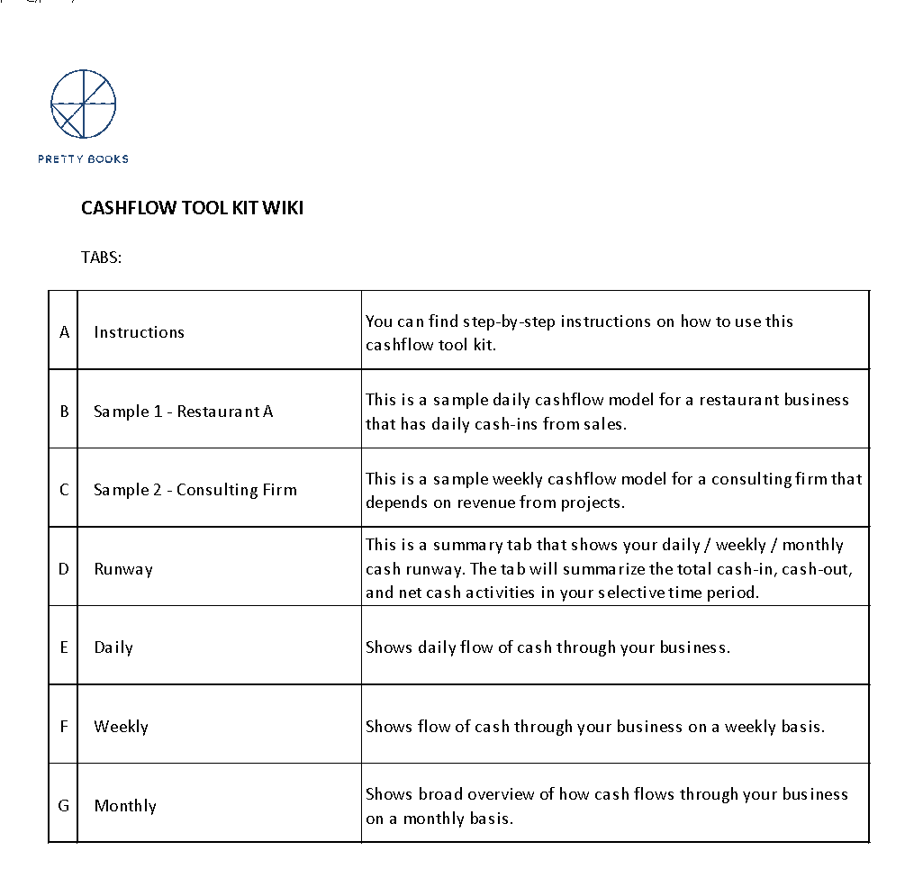
Toolkit - Cash flow management.
Toolkit
Ready to use cash flow templates.
With this Cash Flow Tool Kit, you will be able to:
1. Track your daily / weekly / monthly cash flow
2. Predict upcoming cash inflow and cash outflow
3. Adjust your assumption
4. Review daily / weekly / monthly runway
5. Evaluate your future cash position

Slide 14
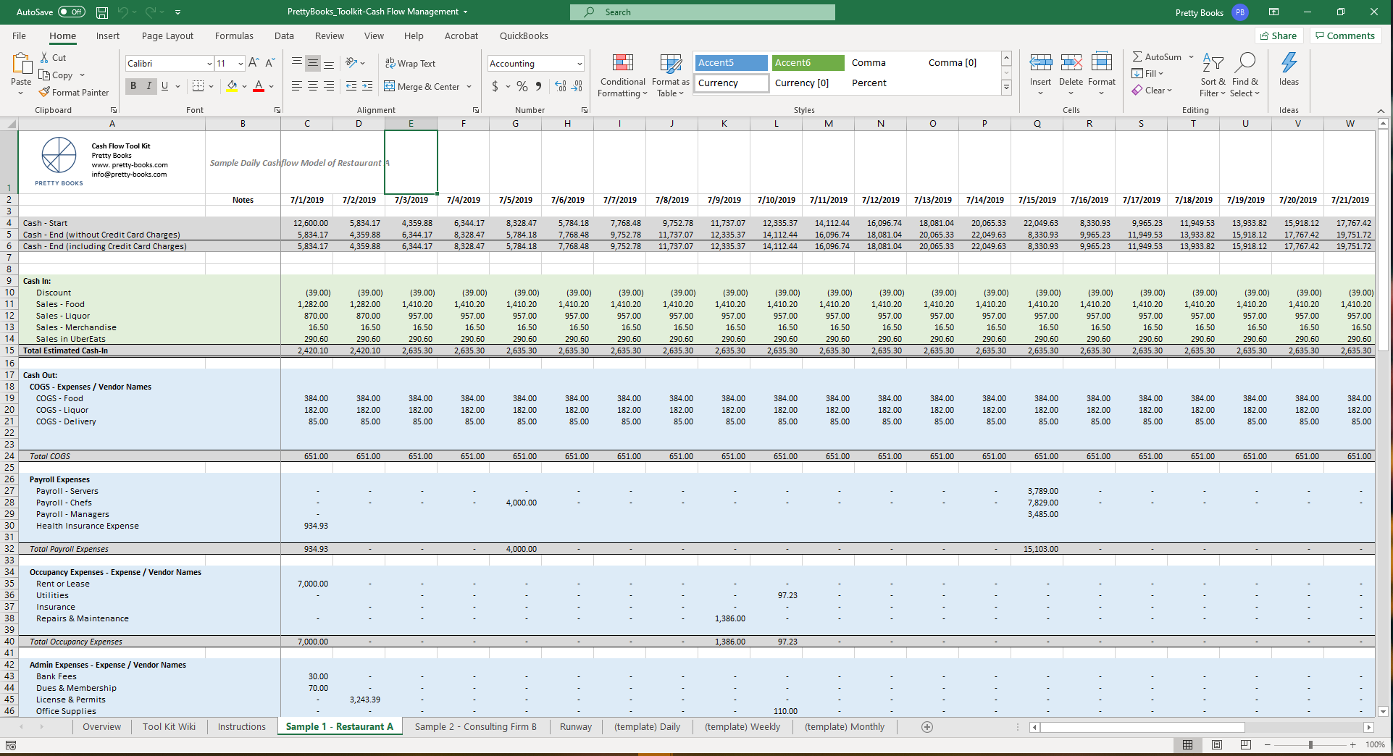
Cash flow templates with instructions and samples.

Slide 15

Cashvue – Cash Flow Management for Teams
A collaborative web platform where users can easily forecast, track and manage operational cash flow all in one place.
01
Forecast effortlessly.
// Automate assumptions and easily update inflows and outflows against time.
02
Work collaboratively.
// Collaborate with financial and non-financial team members to landscape upcoming cash expectations.
03
Intuitive visualizations.
// Intuitive visuals and graphs to aid in cash flow analysis and flag any short falls.
04
Easily track and adjust assumptions.
// Track all inflows and outflows, easily adjust assumptions accordingly.
Notes:
Provide a technology solution that would make the process of day-to-day cash flow management inside companies simpler, easier.
Imagine an agile financial management process.
Imagine you are a executive at a fast paced - growing company. You can log into Cashvue, and you can see your cash position anytime in the future. And your management team and finance team can work together and constantly tailor the assumptions based on new information.
This transparency and clarity put you and your team ahead of the game.

Slide 16
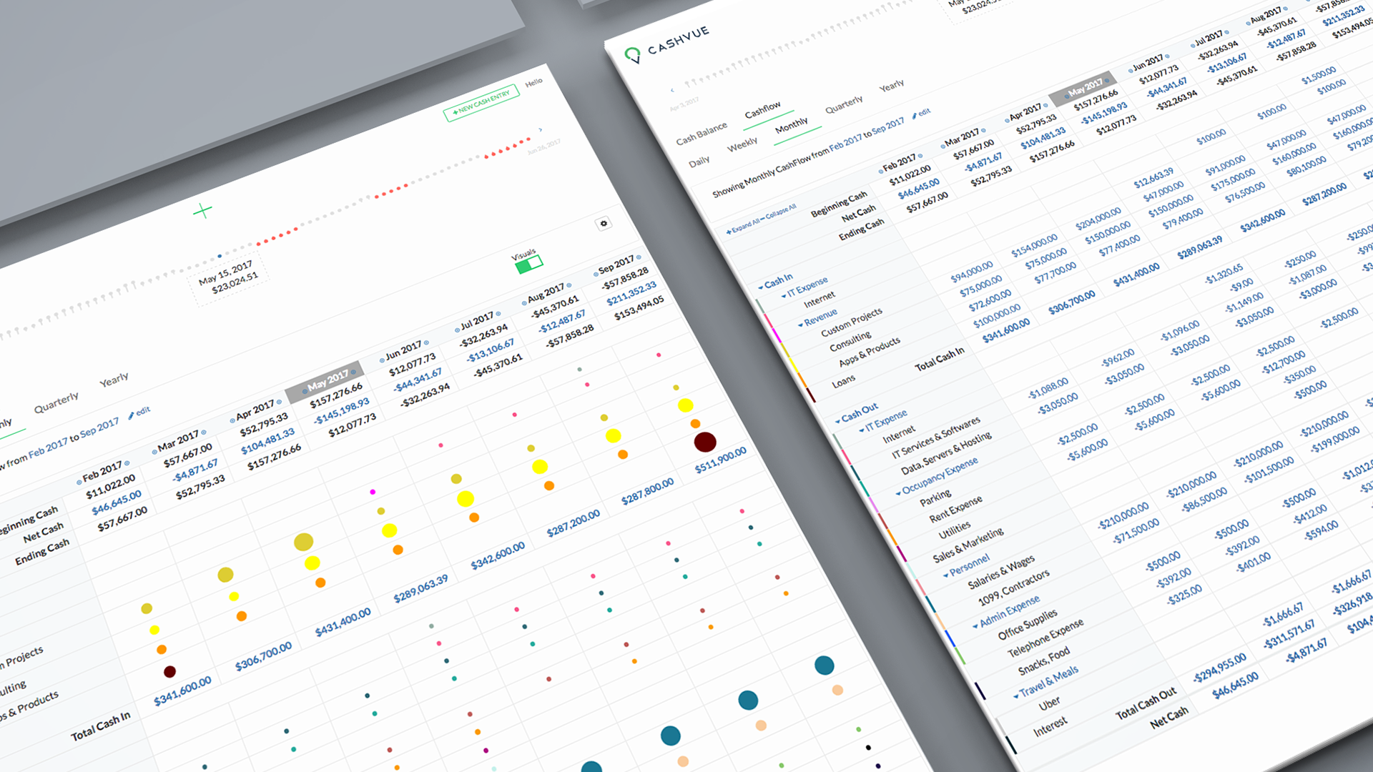

Automated cash flow projections.
love what you do
// Second Tagline
love what you do
// Second Tagline
love what you do
// Second Tagline

Slide 17
Manage your cash flow today.
01
Project cash inflow and cash outflow expectations 90 – 180 days into the future.
Take control, manage your cash flow.
02
Adjust and revise cash expectations based on new information.
03
Evaluate your business. Review and update cash expectations weekly.

Slide 18

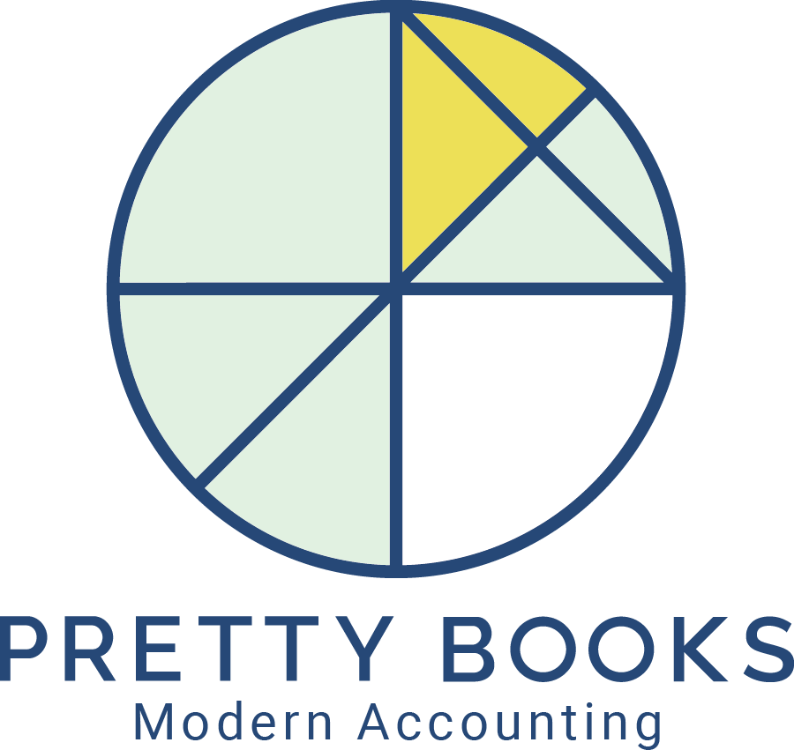
Reach out if you need help.
Pretty Books, LLC
200 1st Ave W, Suite 240
Seattle, WA 98119
Web: pretty-books.com
Email: info@pretty-books.com
Phone: 888-785-9580

